Slide 1
Scanning and Enumeration

Slide 2
Scanning
Active reconnaissance is commonly referred to as scanning.
Taking the information discovered during reconnaissance and using it to examine the network.
The process of scanning perimeter and internal network devices for weaknesses.
Looking for information that can help to perpetrate attack

Slide 3
Scanning
Open ports and network services
Open services
Open share drives
Open FTP portals (Weak protection of data in transit)
Vulnerable applications, including operating systems
Each piece of LAN/WAN equipment
Find the network topology
Network addresses of live hosts, firewalls, routers, etc
List of potential vulnerabilities

Slide 4
Scanning tools
Tools for scanning
Diallers
Nmap
Nessus
AngryIPScanner,
Softperfect scanner
GFI Languard
Superscan
Netcat
NeoTrace
Cain&Able

Slide 5
Types of Scanning
Types of scanning.
Port Scanning
Network Scanning
Vulnerability Scanning
Scan for the open Ports
finding active hosts on the Network
Finding system vulnerability

Slide 6
Port Scanning

Slide 7
What is a port? Why we need it?
Ports are used for routing incoming information from a network to specific applications to a designated machine.
A Port is associated with an IP address of the host, as well as the type of protocol (TCP, UDP, SC)used for communication.
An IP Address identifies what host we want our data to go to, but not which of the many processes. In Internet this is the port number.

Slide 8
Example: Port no.
Web servers usually "listen on" port 80.
Web servers open this port then listen for incoming connections from web browsers.
So, when you give the URL http://www.usna.edu/,
the browser asks DNS to resolve name to IP 136.130.88.145
Then sends its GET request to 136.130.88.145 on port 80
because web servers uses port 80.

Slide 9
PORTS
Types of Ports
Physical Ports
Virtual Ports
Ethernet ports
USB ports
Serial/Parallel ports
connect the Keyboard, monitor, Mouse, Modem
total 0-65535 ports
Each for TCP and UDP

Slide 10
Ports are divided into
Port (65535)
(0-1023)
Well Known/System Ports
(1024-49151)
The Registered/User Ports
(49152-65535)
The Dynamic and/or Private Ports
e.g. 21-File Transfer Protocol (FTP)
e.g. 22- Secured shell (Ssh)
Used for updates
used by the applications that communicate using TCP or UDP
Companies and other users register with ICANN
Customized services
For each TCP and UDP
Temporary purposes
Automatic allocation of ephemeral ports

Slide 11
Registered and Private Ports
Registered ports :
1234 : VLC
1220 : Qicktime Server Admin
1935 : RTMP
2948, 2949 : MMS
3306 : MySQL
5004, 5005 : RTP
5060, 5061 : SIP
5269 : XMPP
5500, 5800, 5900 : VNC
8008 : HTTP Alternate
25565 : MySQL

Slide 12
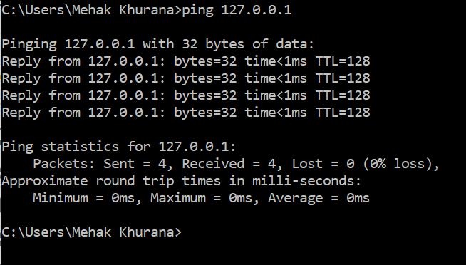
In class Task: To identify OS
445, 135 -> Microsoft is using this port to provide service
cmd (windows)
Ping 127.0.0.1
See the response?? TTL
TTL=128
Windows Based Machine

Slide 13
In class Task: To identify OS
Terminal (Linux)
Ping 127.0.0.1
What is the response??
TTL= 64
Linux Based OS

Slide 14
To identify server
If it is a server
Then ttl might variate e.g. ttl=53 for google server
If I ping on the system on port 445
If I get a response, it is windows
If no response it is Linux

Slide 15
In class task
Task: what is port hardening
Hint : Ports are blocked for security

Slide 16
Port Scanning
Port status
Open
Closed
Filtered
Closed|filtered
Open|filtered
For non-security scans
Primary Goal
No application listening on it.
Shows host is up on an IP address
Packet filtering
Dedicated firewall device, router rules
Unfiltered
Port is open or closed
ACK scan classifies ports into this state.
WIN scan, SYN scan, or FIN scan may classify the port is open
open or filtered
No response
port is closed or filtered.

Slide 17
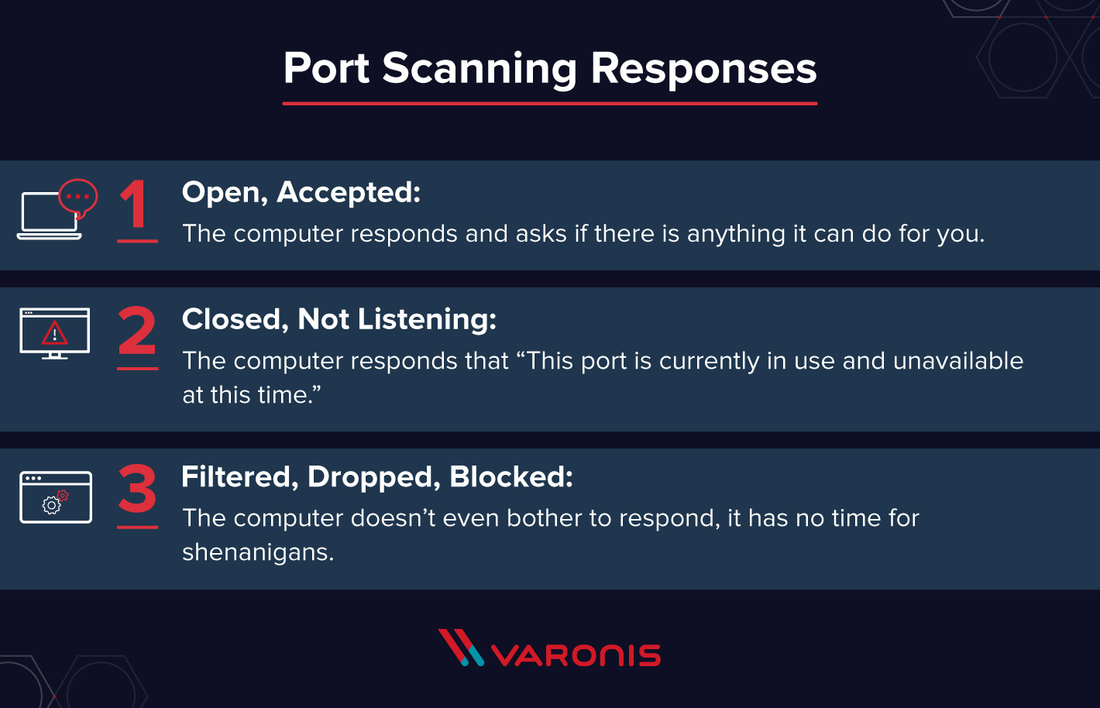
Port Scanning

Slide 18
Tool for Port Scanning: Nmap-CLI and GUI based

Slide 19
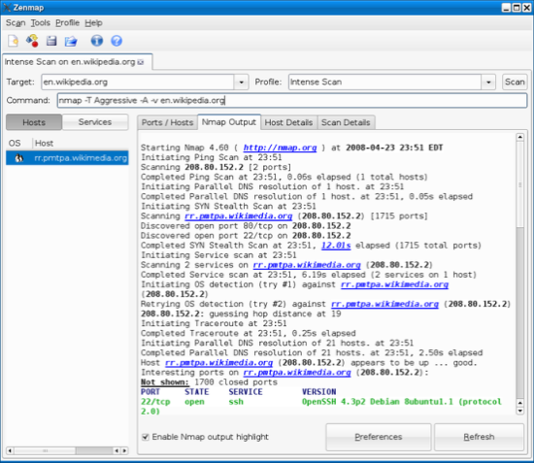
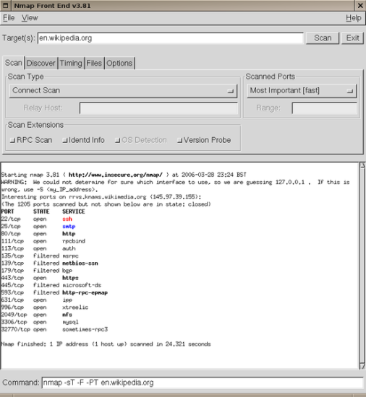
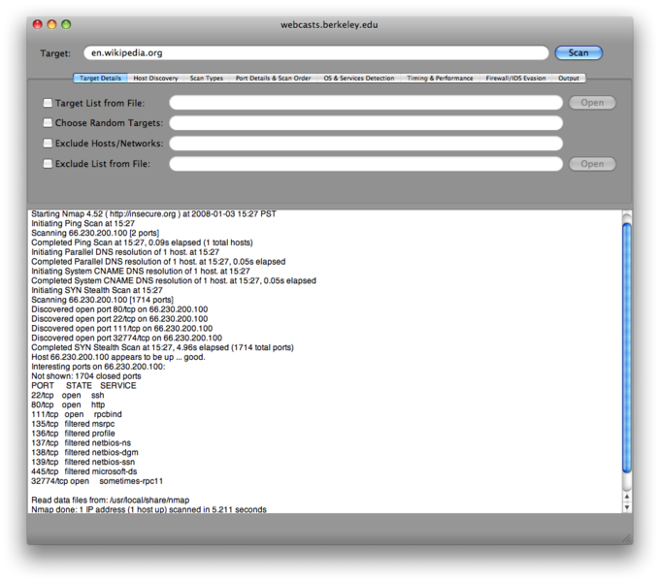
Tool Environment
Runs on Linux, Windows, Mac OS X and other smaller operating systems
GUI options:
Zenmap
XNMap
NmapFE

Slide 20
NMap
Nmap (Network Mapper) was released in September 1997
It is a free and open source utility for
Network discovery
Security auditing
Determines the following
The up or down status of a host
Network services available on a host
Presence of a firewall
Operating system and version used on host
Name and version of services running on host

Slide 21
How Nmap Works?
It uses DNS lookup- It matches name with IP address
It pings the remote target with 0-byte packets to each port
Sends different packets with different timing to determine filtered/unfiltered, version, etc.

Slide 22
Nmap features
Regular Scan
Attempt full connection with port
Attempt partial connection with port
Stealth scanning
Scanned system knows scan is occurring
System may not know scan is occurring
May not be able to identify scanner
Can identify scanner
SYN, ACK+SYN, ACK
SYN, ACK+SYN

Slide 23
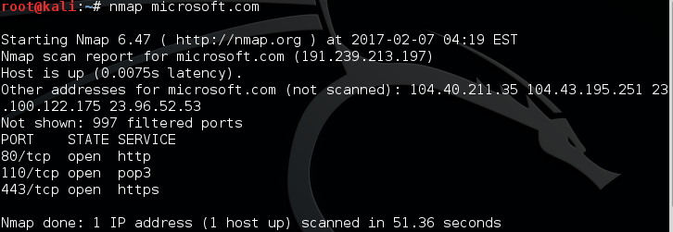
Basic scanning with Nmap
1. nmap <target> IP or Domain name
scans 1,000 TCP ports on the host <target>.
e.g. nmap 192.239.213.197/ www.Microsoft.com
It will provide the following information
Start Time
IP
Host and RTT
Ports and their status
Filtered Ports

Slide 24
Nmap commands
How will you identify is this machine-linux/windows?
In windows, 3 ports will always be open
135 - msrp
139 - netbios-ssn
445 – Microsoft-ds
Try on Linux machine- Take IP address of Linux- all these 3 ports are closed
Now start any service
Service smbd start
Now again run on Linux to check ports open
Check for all ports
It will show 2 ports to be opened

Slide 25
Nmap scan commands

Slide 26
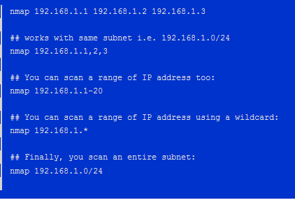
Nmap Examples
2. Scan multiple IP address or subnet (IPv4)
Nmap 192.168.195.1-255 (check for whole range of IP from 1 to 255)
Nmap 192.168.195.1/16
It will check for 254 hosts (16 network and 16 host)
Nmap 192.168.1.*

Slide 27
Nmap commands
Check specific port open/closed
3. Nmap –p 25 192.168.195.249
Port is closed
Start XAMPP
Start Mercury
Again run nmap command
Port open
Check specific range
3a. Nmap –p 1000-1200 192.168.195.249
Scans from 1000-1200
Fast because less scan

Slide 28
Nmap Examples
Nmap -p T:80 192.168.1.1
Nmap -p U:53 192.168.1.1
Nmap -p 80,443 192.168.1.1
Nmap -p U:53,111,137,T:21-25,80,139,8080 192.168.1.1
Nmap --top-ports 5 192.168.1.1 ## Scan top ports i.e. scan $number most common ports
Nmap --top-ports 10 192.168.1.1
Check all port range open/closed
Nmap –p 0-65535 192.168.195.249
Nmap –p- 192.168.195.249
Nmap –p “*” 192.168.195.249

Slide 29
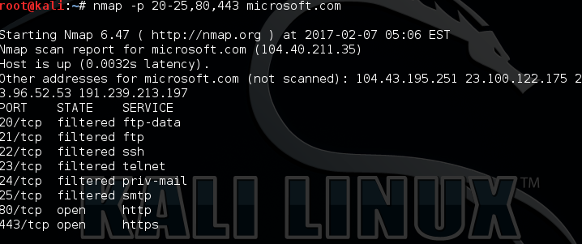
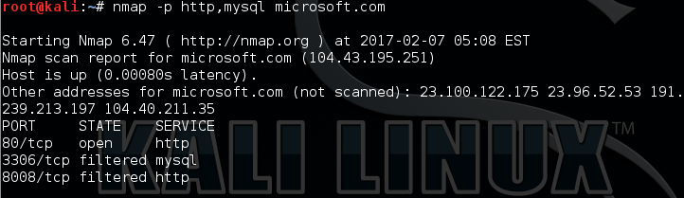
Scan on Specific port

Slide 30
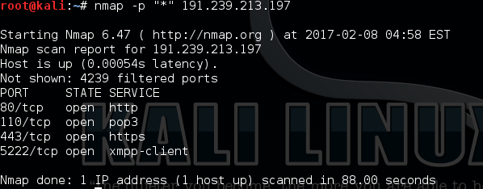
Scan on all port

Slide 31
Nmap commands
Find OS
4. Nmap –O 192.168.195.249
Device type: general purpose
If android- smartphone
If IOS- Iphone
OS details: it tells on the basis of services
If So many OS then how to find which OS to be attacked, but attack is performed on service
Nmap -O --osscan-guess 192.168.1.1
Nmap -v -O --osscan-guess 192.168.1.1

Slide 32
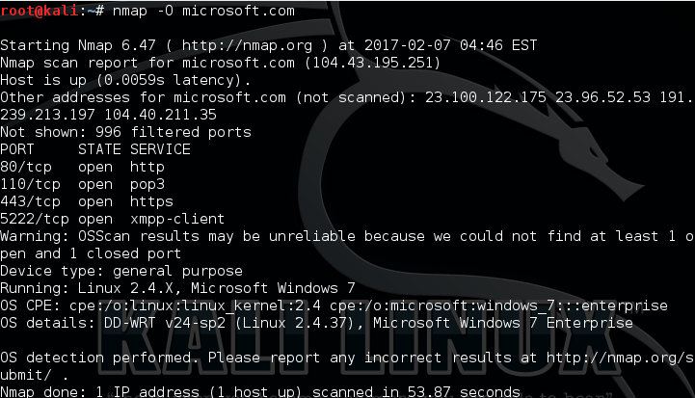
Remote Host OS Detection

Slide 33
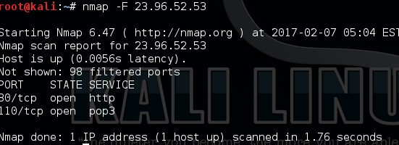
Nmap commands
-
For Fast scan
5a. Nmap -F 192.168.195.249
F means that we going to scan 100 most popular ports (this option also required for quick scans)
5b. Nmap –T4 192.168.195.249
T1 1 packet in 1 sec
T4 4 packets in 1 sec or in gap of 4 secs- more power smooth scan/fast
T4 this setting is required to set up scan speed (T5 is the maximum, most aggressive scan)

Slide 34
Nmap commands
Nmap by default scans TCP then how to scan UDP
Nmap for UDP
6. Nmap –sU 192.168.195.249
-s script
U to find udp ports
Shows name of computer- Windows 7 ultimate 7601 service pack
System time
Date
Level
Account-used:guest
OS
6a. Stealthy scan
nmap -sS 192.168.1.1
6b. TCP ports using TCP connect scan (warning: no stealth scan)- OS Fingerprinting
nmap -sT 192.168.1.1
6c. Find out the most commonly used TCP ports using TCP ACK scan
nmap -sA 192.168.1.1 rst
6d. Find out the most commonly used TCP ports using TCP Window scan
nmap -sW 192.168.1.1

Slide 35
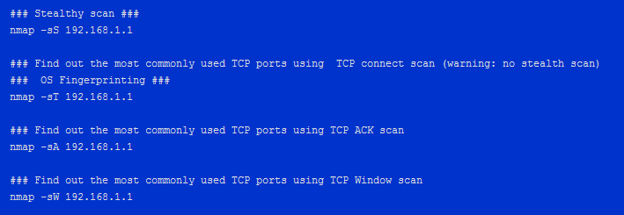
Nmap Examples
Find out the most commonly used TCP ports using TCP SYN Scan

Slide 36
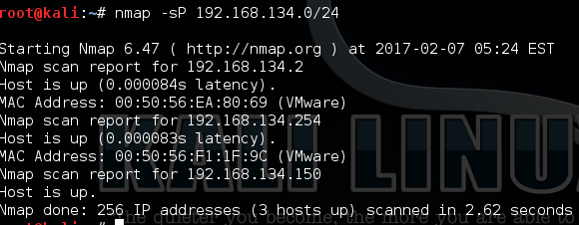
Nmap Examples
6. Detect remote services (server / daemon) version numbers:
Nmap –sV 192.168.195.249
-s script /--script
V Verbose
6. if a host/network is protected by a firewall
Nmap –sA 192.168.195.249
6. Scan a network and find out which servers and devices are up and running (host recovery)
This is known as host discovery or ping scan:
Nmap –sP 192.168.195.249

Slide 37
Nmap Examples
7. This type of scan allows you to determine which IP protocols (TCP, ICMP, IGMP, etc.) are supported by target machines:
nmap -sO 192.168.1.1
8. Nmap –sS –sV –sC 192.168.195.249
-s script /--script
S sync
V Verbose-> bring data from/of header
C default script scan

Slide 38
Nmap commands
There are total 599 NSE scripts
They are in a folder in our system
Path-other location- usr/share/nmap/scripts
Cd path usr/share/nmap/scripts
Now run the next command (9, 10)
Check Specific Vulnerability
9. Nmap –sV --script=rdp-vul-ms12-020 192.168.195.249
rdp-vul-ms12-020 is vulnerability
Command Checks if a machine is vulnerable to MS12-020 RDP vulnerability.
Rdp- remote desktop protocol
The Microsoft bulletin MS12-020 patches two vulnerabilities:
CVE-2012-0152 which addresses a denial of service vulnerability inside Terminal Server, and
CVE-2012-0002 which fixes a vulnerability in Remote Desktop Protocol.
Both are part of Remote Desktop Services.

Slide 39
Nmap commands
Now I want to run to check all the vulnerabilities that exist
10. Nmap --script vuln 192.168.195.249
http-csrf: CSRF vuln
/wordpress/:Blog ->192.168.195.249/phpMyAdmin or wordpress
Vulnrability: Diffie Helman
Scripts
Check Specific Vulnerability (In Class Task)
Vulnerable
Remote code Execution- (ms17-010)- attack series
CVE-2017-0143
Factor: high
84 zero days
Display help for the individual scripts.
--script-help=$scriptname

Slide 40
Nmap commands
Aggressive Scan/ Intense Scan
11. Nmap –A –T4 192.168.195.249
A-Aggressive
T4 increase power of nmap
Gives service
OS
Scripts –sT, -sS
Traceroute

Slide 41
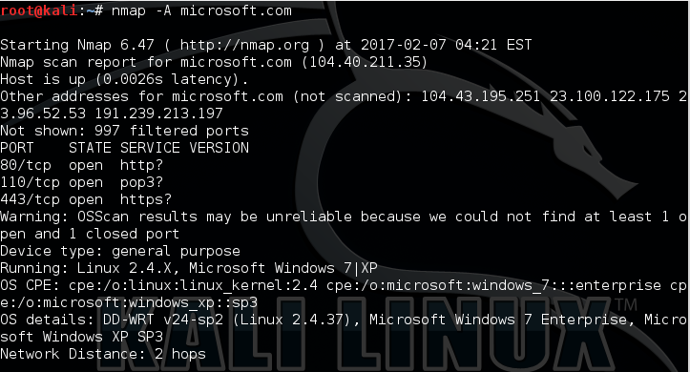
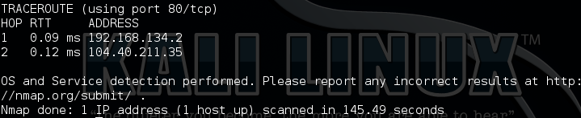
Aggressive Scan-OS & Service Detection

Slide 42
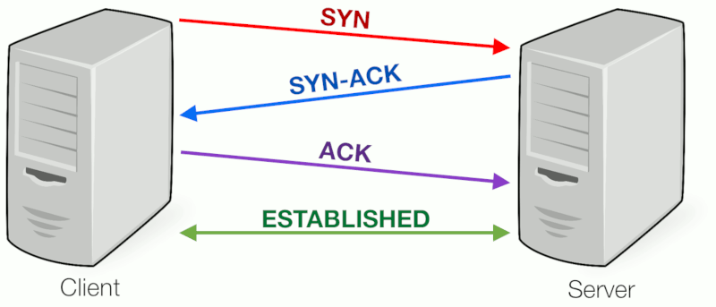
Nmap commands
3-way handshaking

Slide 43
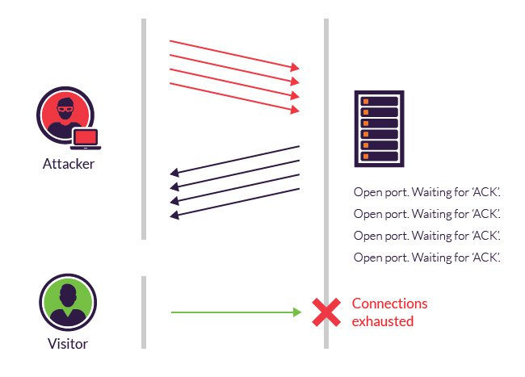
Nmap commands
What does attacker do? 3-way handshaking
It sends multiple SYN packets to the target and open port sends ACK+SYN but attacker will discard SYN and takes ACK and each ack packet/header has data

Slide 44

Nmap Examples
12. Scan a host when protected by the firewall
Try ping when firewall is off
12a. Ping 192.168.195.249
Reply icmp packets
Try ping when firewall is on
Ping 192.168.195.249
No reply/ blocks ICMP packets

Slide 45
Nmap commands
Nmap by default uses ICMP but if On firewall (window setting), it block and does not send ACK/ blocks ICMP packets
13. nmap 192.168.195.249
Blocks ICMP packets
Each firewall blocks-ICMP traffic packets i.e. blocks ACK
This can help to check firewall is off/on
14. Traceroute www.google.com
30 hops max
We do not reach google directly, we go to 8-9 machines in between to reach google.

Slide 46
Nmap Commands
15. Nmap –Pn --script firewall –bypass –p 135,139,445 192.168.195.249
-P Ping, Pn is ping not i.e. will not send ICMP packets
--script
Firewall-bypass- socket randomise (IP: Port)- will keep on changing port no.
15a. Nmap –Pn --script firewall-bypass –disable-arp-ping –p 80, 443
Disable-arp-ping-Arp is network layer protocol
Arp plays a role of communication in network layer

Slide 47
Nmap Examples
16. Scan a firewall for security weakness
The following scan types exploit a subtle loophole in the TCP and good for testing security of common attacks:
TCP Null Scan to fool a firewall to generate a response ## ## Does not set any bits (TCP flag header is 0)
nmap -sN 192.168.1.254
## TCP Fin scan to check firewall ## ## Sets just the TCP FIN bit ##
nmap -sF 192.168.1.254
## TCP Xmas scan to check firewall ## ## Sets the FIN, PSH, and URG flags, lighting the packet up like a Christmas tree ##
nmap -sX 192.168.1.254

Slide 48

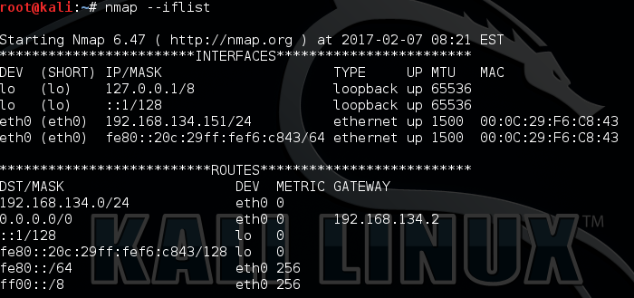
Nmap Examples
17. Only show open (or possibly open) ports
18. Show host interfaces and routes
This is useful for debugging
Nmap --iflist

Slide 49

Nmap Examples
19. Read list of hosts/networks from a file (IPv4)
The -iL option allows you to read the list of target systems using a text file. This is useful to scan a large number of hosts/networks. Create a text file as follows: cat > /tmp/test.txt
Sample outputs:
server1.cyberciti.biz
192.168.1.0/24
192.168.1.1/24
10.1.2.3
localhost

Slide 50
Nmap commands (Summary)
Nmap 192.168.195.249
Nmap –p 25 192.168.195.249 // open port
Open xampp, open mercury then again check
Nmap –p 0-100 192.168.195.249 //range of ports
Nmap –p 0-65535 192.168.195.249 //all ports
Nmap –p- 192.168.195.249 //all ports
Nmap –sU 192.168.195.249 //udp Scan
Nmap –sS –sV –sC 192.168.195.249
Nmap –o 192.168.1195.249 // Operating system
Nmap --script rdp-vul-msl2-020 192.168.195.249 //specific vulnerability scan
Nmap --script vuln 192.168.195.249 //Vulnerability scan

Slide 51
Nmap commands
Nmap –A –T4 192.168.195.249 //Aggressive Scan
Ping 192.168.195.249 //ICMP reply
Nmap –Pn --script firewall –bypass –p 135,139,445 192.168.195.249 //firewall bypass
Nmap –Pn --script firewall-bypass –disable-arp-ping –p 80, 443 //disable arp

Slide 52
Task-Explain the following command
Explain all the commands
Explain the output
Screenshot of the output
In class task commands
Spoof IP
Spoof MAC

